Slide 1


Slide 2

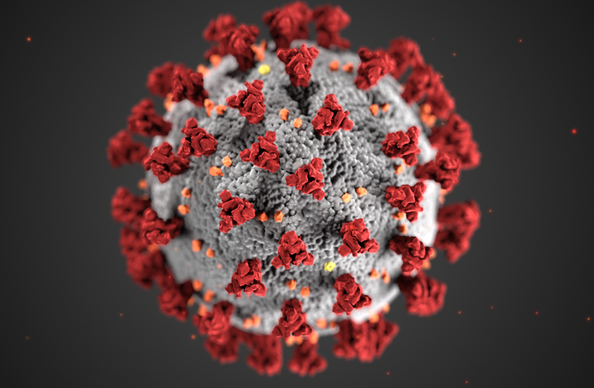
Covid19-USA Capstone Project
By Hemanth Musunur

Slide 3
Agenda
Intro to Covid
Timeline of Cases
Statistics
Recommendation
Implementation

Slide 4
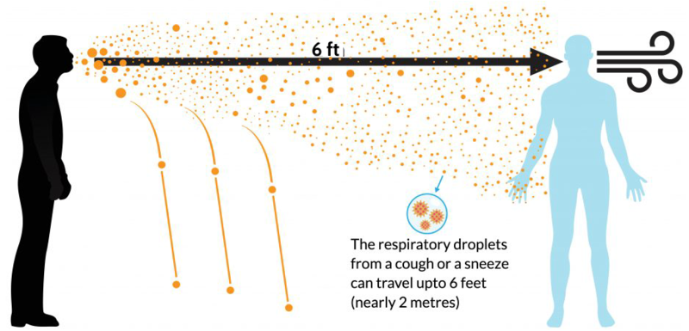
Covid-19
Covid-19 is a respiratory illness that can be spread through respiratory droplets.
First Case reported in Wuhan, China on Dec. 31, 2019
Symptoms include fever, cough, muscle pain, tiredness, breathing difficulty
Cases both pre-symptomatic and asymptomatic.

Slide 5
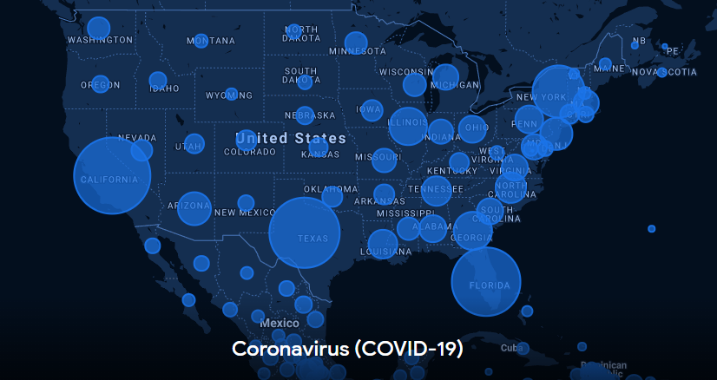
USA Covid-19 cases
First case reported January 20, 2020
First death Feb. 28, 2020
6.5 million cases as of September 2020
192k deaths as of September 2020

Slide 6
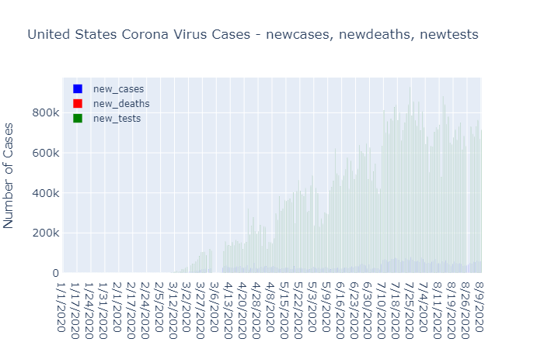
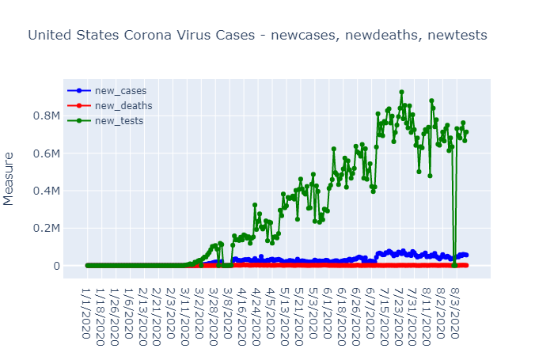
U.S timeline of cases
First rise in cases, March 2, 2020
From March 3-August 3, 2020, new tests outpaced new cases and new tests

Slide 7
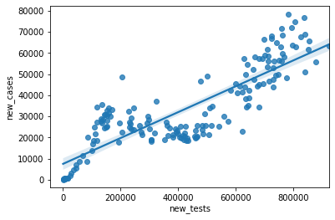
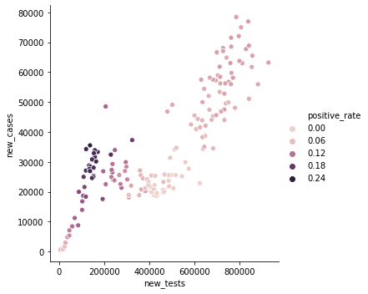
Statistical analysis
Positive correlation between new tests and new cases.
When new tests increase, new cases expected to increase.
New tests expected to increase past August well into 2021.

Slide 8
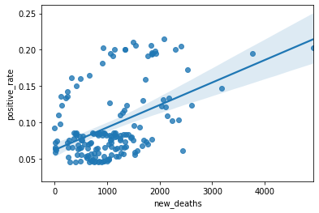
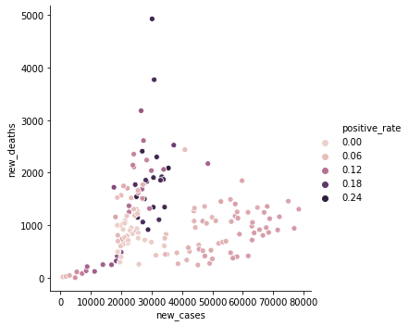
Statistical analysis cont.
Positive correlation between new deaths and positive rate.
Positive correlation between new cases and new deaths.
New deaths expected to increase alongside new cases.

Slide 9
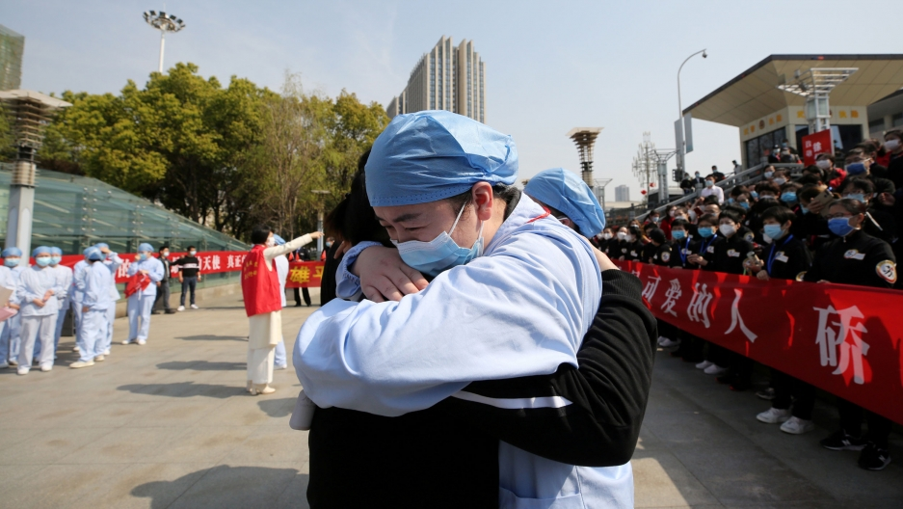

Recommendation/Goal
70-80 % of population tested within each state.
Daily case rate should reach less than .5% for each state
Vaccine ready for deployment by February 2021 .
Contract tracing of 80 percent of population.
Vaccine distributed to 50 percent of population by August 2021.

Slide 10


Implementation
Increase in Federal Funding for PPE, ventilators and hospital equipment, as well as vaccine development
Online Learning for public schools and shutdown of large events, concerts, conferences from October till August 2021.
CDC guideline for every state for reopening.
Stimulus checks and business loan assistance for businesses shut down and heavily impacted.

Slide 11
Thank You!

Slide 12
Works Cited
https://ourworldindata.org/coronavirus-source-data
https://www.cdc.gov/

